Slide 1
Developing Low Code Apps
Pravin Y Pawar

Slide 2
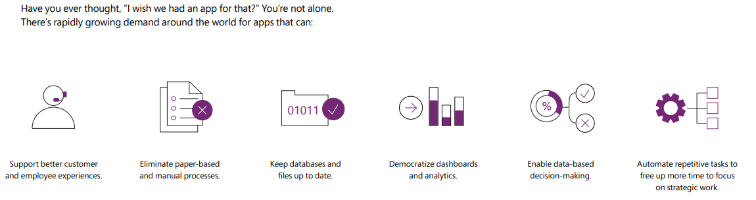
Turn your business ideas into apps
no coding experience required

Slide 3
Developing Low Code Apps
You might think that building apps like that would require teams of developers to write the code line by line
In the past, it would have!
But today, with an innovative approach known as “low-code” development, you can build them yourself!
Using existing data, prebuilt connectors, and Excel-like expressions, nontechnical workers are becoming app developers
Democratizing app development across an organization is creating opportunities for individuals and organizations alike to transform the way they work
These new apps are becoming part of the fabric of the workday across organizations of all kinds.

Slide 4

Citizen developer
Ready to make your business ideas a reality?
With LCAP, you can
rapidly automate processes
build custom apps to meet your business needs
easy to start small with prebuilt templates and in-app guidance to deliver quick wins
if needed, pro developers can extend Power Apps for fully custom solutions
Solutions connect to a wide range of data sources for maximum flexibility
Apps you build work seamlessly across the web, iOS, and Android devices
Source : youtube

Slide 5
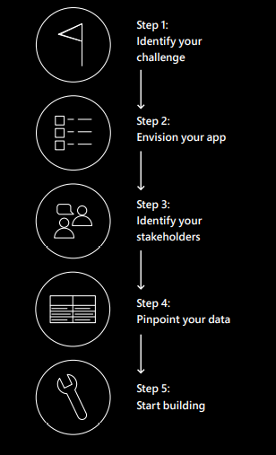
Get started with low-code apps in 5 simple steps

Slide 6
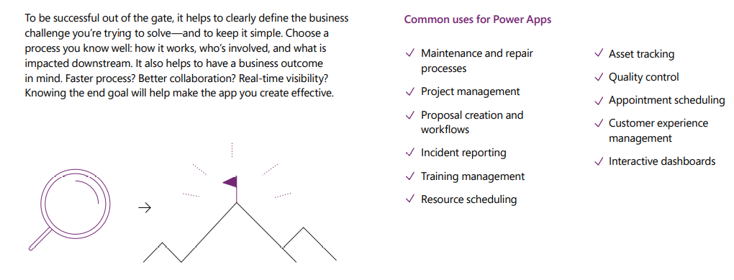
Step 1: Identify your challenge

Slide 7
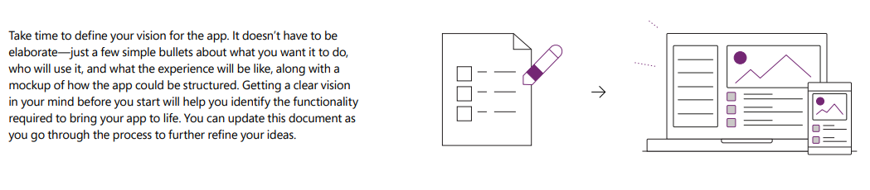
Step 2: Envision your app

Slide 8
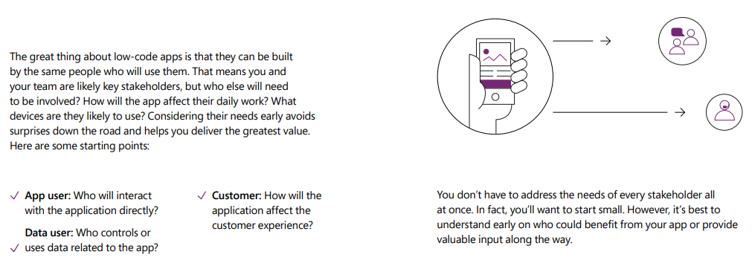
Step 3: Identify your stakeholders

Slide 9
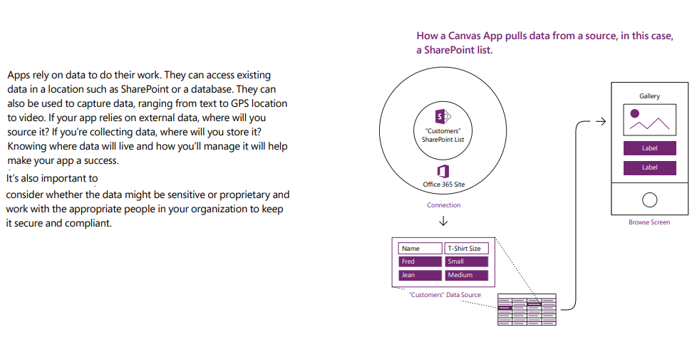
Step 4: Pinpoint your data

Slide 10
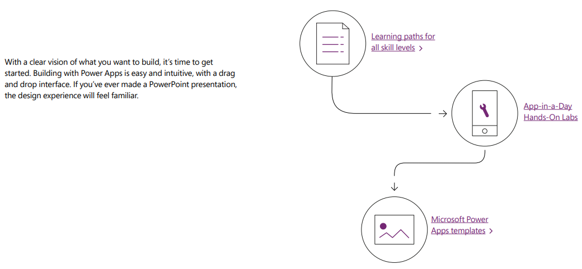
Step 5: Start building

Slide 11
Thank You!
Reference:
The DIY Guide to Building Your First Business App
Turn bright ideas into brilliant apps
by Microsoft
In our next session:

